Slide 1


Logistic Regression
Predicting the Coronary Heart disease chances Presented by- Nirvi Khiyani

Slide 2

Abstract:
The traditional way of analyzing binary classification problem is Logistic regression, however, it comprises of many iterations and huge amount of data. In this report, we will study the logistic regression model, its mathematical representation and the implementation. In order to actualize the predictive and probabilistic approach , this report will adhere logistic regression as machine learning the most significant heart diseases predicators and hence, using logistic regression for predicting the overall risks. Therefore, one of the classification algorithms like logistic regression is implemented to identify the predicators .For this we have used the Framingham dataset that comprises of 4240 patient’s data and 15-attributes. Finally, the analysis of data and implementation of code is carried out in Jypter in python

Slide 3
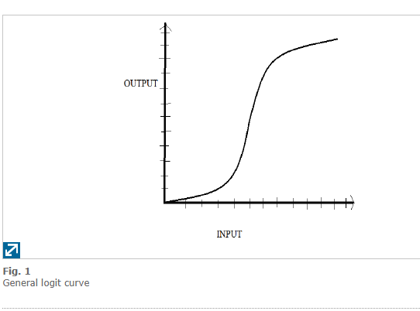
What is Logistic Regression
Logistic regression uses various predictor variables which can be either categorical or numerical. The inputs to this are independent features and output will be categorical. In logistic regression model, the probability of occurrence of categorical output is achieved by fitting feature in logistic curve. The below mentioned figure is the logistic curve:

Slide 4

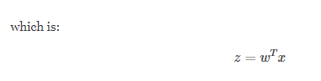
The process of classification of logistic regression can be stated as under:
If the input data ranges from x0 to xn, then all the features are multiplied by the regression coefficients that range from w0 to wn and therefore the sum of the sigmoid function would be
In General it could be

Slide 5
Why use logistic regression?
There are many important research topics for which the dependent variable is "limited."
For example: voting, morbidity or mortality, and participation data is not continuous or distributed normally.
Binary logistic regression is a type of regression analysis where the dependent variable is a dummy variable: coded 0 (not having disease) or 1(having a disease)

Slide 6
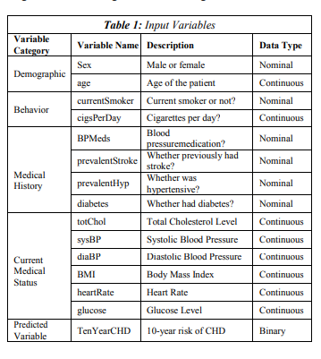
Example: Predicting Coronary heart disease risks
For my logistic regression model, I have chosen the Framingham dataset there is one variable that needs to be predicted and 14 IVS. In this the outcome could be 0 or 1 i.e.; Binary. It is stated as in the table :

Slide 7
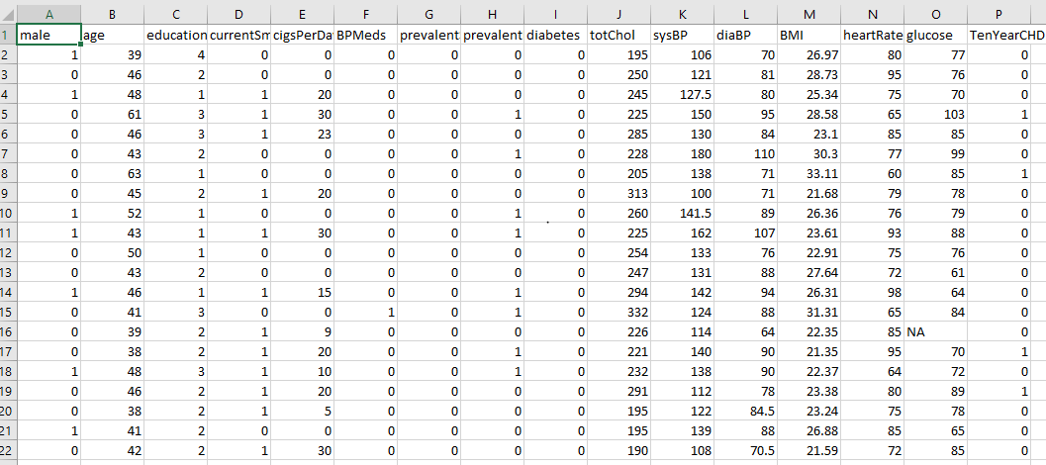
Dataset
Dataset:

Slide 8
Hypothesis: To develop a model that determines contracting Coronary heart disease risks.
Logistic Model:
The attributes that are risk Factors for the coronary heart disease as my data are :
Smoking
Total Cholesterol level (TCL-200)
Body Mass Index (BMI -25)
Gender(1=Male, 0= Female)
Age( in years less than 50)
Hours of physical activity (weekly)

Slide 9
Output of Logistic Regression Model
Risk of Coronary Heart Disease
Regression Output | Regression Beta | Sig | Odds Ratio (Exponential Beta)
Smoking | 0.898 | 0.0292 | 2.455
Total Cholesterol level (TCL-200) | 0.166 | 0.015 | 1.181
Body Mass Index (BMI -25) | 0.058 | 0.120 | 1.060
Gender(1=Male, 0= Female) | 0.028 | 0.038 | 1.028
Age( in years less than 50) | 0.024 | 0.024 | 1.024
Hours of physical activity (weekly) | -1.013 | 0.006 | 0.363

Slide 10
From the previous slides, we can see which of the variables are most influential in determining the risk factors is most relevant when considering Coronary Heart diseases. For an instance, smoking and the if the cholesterol level more than 200 are at highest risk of suffering.
After examining the results, Odds ratio’s are used for interpreting the result. Smokers are at the highest risk of 2.4times more than the non-smokers. Infact, high-cholesterol and age are also risk factors. Next, men's are slightly more who will suffer from coronary heart disease then women and finally, the physical activity reduces the chances of contacting disease i.e.; negative coefficients.

Slide 11
Conclusion:
The objective of this study was to implement the Logistic regression model to find the risk of 10 year CHD by using 14-different variables. In this the backward elimination process is used that contains the value of p which is less than 5% .Hence, logistic model is deprived from the attributes like age, glucose, cigsPerDay, sysBP, totChol. Furthermore, as per the output of the regression model it can be predicted that men are expected to suffer more than women. The odds of the CHD are age, number of ciggrates, systolic blood pressure and .Moreover, no change has been observed for glucose and cholesterol level. However glucose levels have very less odd changes and the model is not sensitive rather it is specific. In the end the accuracy of the model is 0.99882. Finally, ROC curve value is 73.5 which is good but can be improved with more data.

Slide 12
References
[1] Vaidya, "Predictive and probabilistic approach using logistic regression: Application to prediction of loan approval," 2017 8th International Conference on Computing, Communication and Networking Technologies (ICCCNT), Delhi, 2017, pp. 1-6, doi: 10.1109/ICCCNT.2017.8203946.
[2] X. Zou, Y. Hu, Z. Tian and K. Shen, "Logistic Regression Model Optimization and Case Analysis," 2019 IEEE 7th International Conference on Computer Science and Network Technology (ICCSNT), Dalian, China, 2019, pp. 135-139, doi: 10.1109/ICCSNT47585.2019.8962457.
[3] H. Zhang, Z. Li, H. Shahriar, L. Tao, P. Bhattacharya and Y. Qian, "Improving Prediction Accuracy for Logistic Regression on Imbalanced Datasets," 2019 IEEE 43rd Annual Computer Software and Applications Conference (COMPSAC), Milwaukee, WI, USA, 2019, pp. 918-919, doi: 10.1109/COMPSAC.2019.00140.
[4] Nishadi, AS Thanuja. "Predicting Heart Diseases In Logistic Regression Of Machine Learning Algorithms By Python Jupyterlab.
[5] https://repository.maseno.ac.ke/handle/123456789/1164?show=full

Slide 13

[
Thank You

